Slide 1
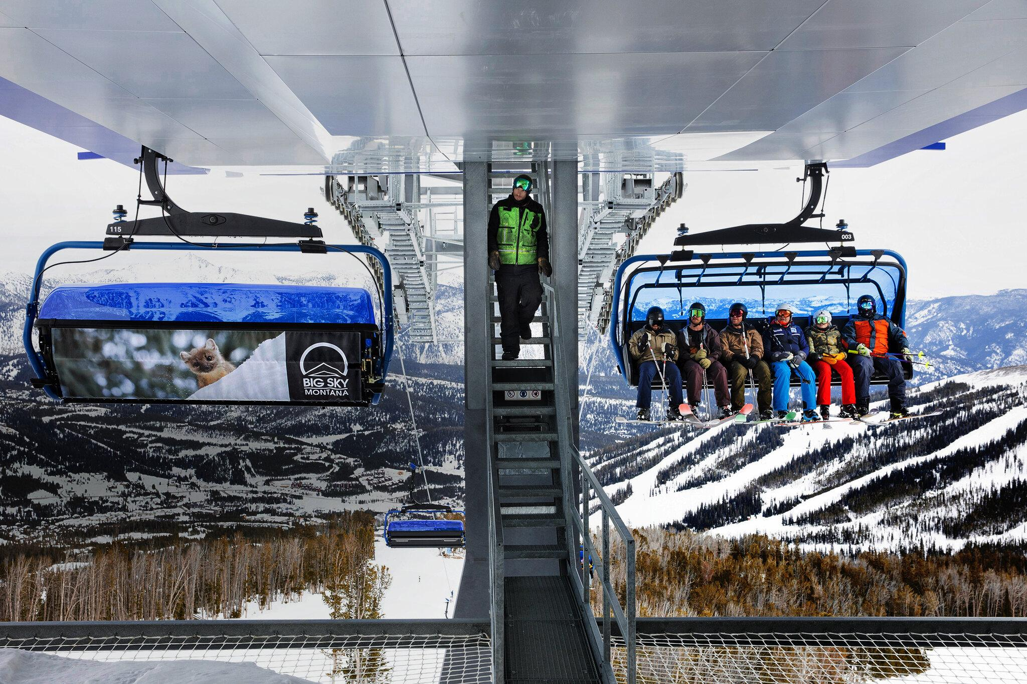
Big Mountain Resort, Montana

Slide 2
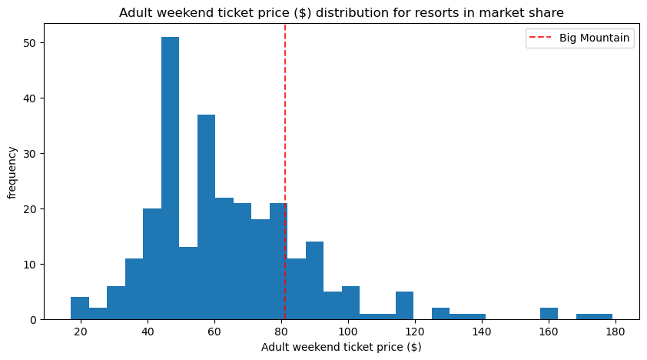
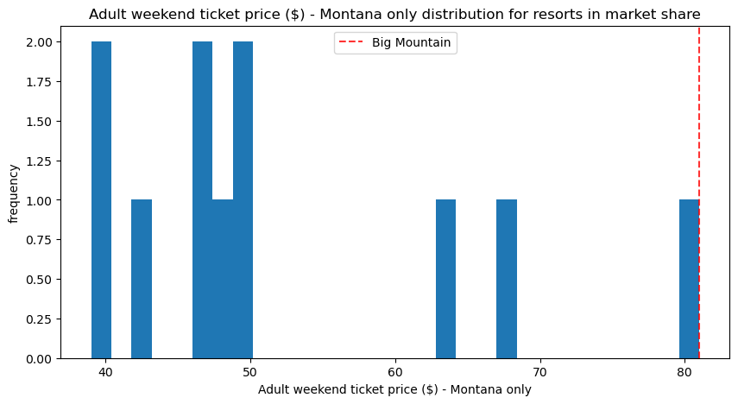
Current Situation and Challenges
Big Mountain Resort currently charges $81.00 per ticket.
Recent addition of a new chair lift increased operating costs by $1,540,000 this season.
Need to optimize ticket pricing to maximize revenue and cover new costs.

Slide 3
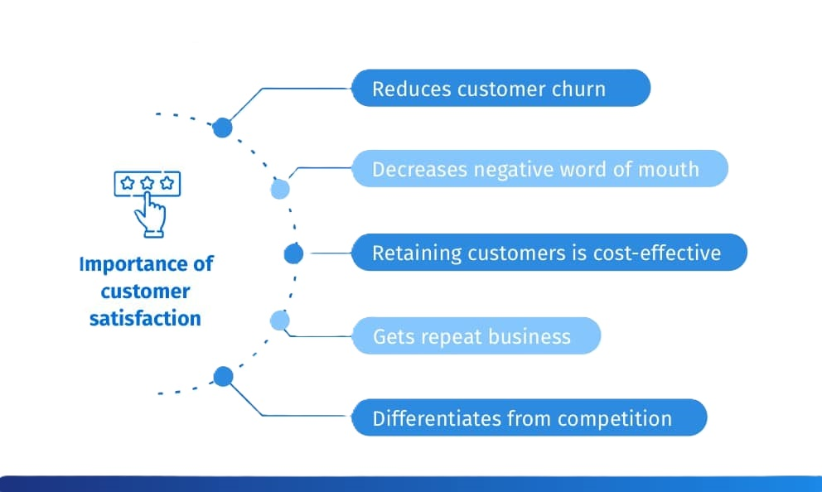
Objectives and Criteria for Success
Achieve a 10% increase in total revenue by the end of the current ski season.
Fully offset the additional operating costs of $1,540,000 for the new chair lift within six months.
Develop and implement a dynamic pricing model.
Maintain or improve customer satisfaction levels.

Slide 4
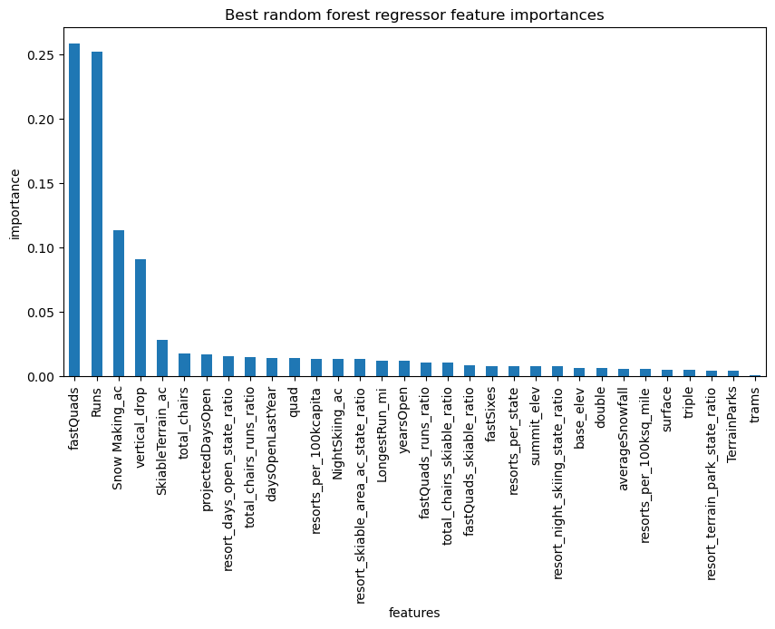
Recommendations and Key Findings
Increase ticket price to $95.87 based on model suggestions.
Important features: vertical drop, snowmaking area, total chairs, fast quads, runs, longest run, trams, skiable terrain.
Scenario analysis suggests focusing on increasing vertical drop and adding a new chair lift.

Slide 5
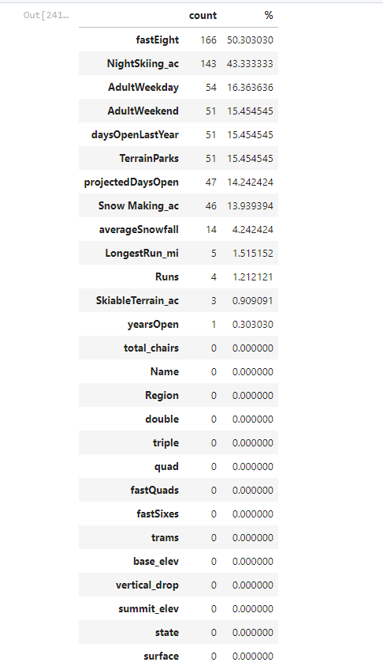
Data Wrangling and EDA
Initial dataset: 330 rows, 27 columns.
Addressed missing data and ensured data integrity.
Exploratory Data Analysis (EDA) findings.

Slide 6
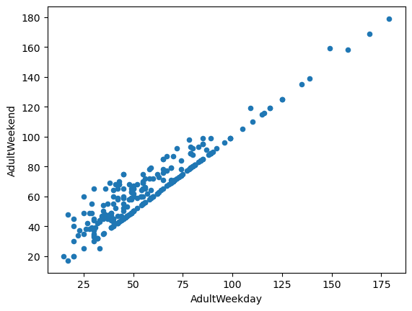
Baseline Model and Linear Regression
Established baseline using average price.
Linear regression model with key features.
Limitations of the linear model.

Slide 7
Random Forest Model
Development of the random forest regressor.
Lower mean absolute error and less variability.
Consistent test set performance.

Slide 8
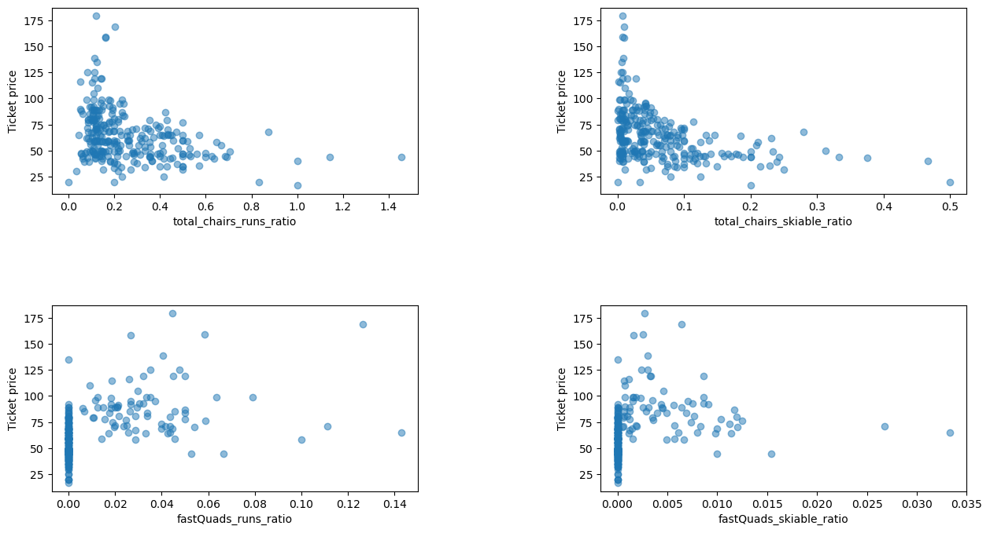
Scenario Analysis
Analysis of scenarios for cost-cutting or revenue increase.
Key findings for each scenario.
Recommendations for future improvements.

Slide 9
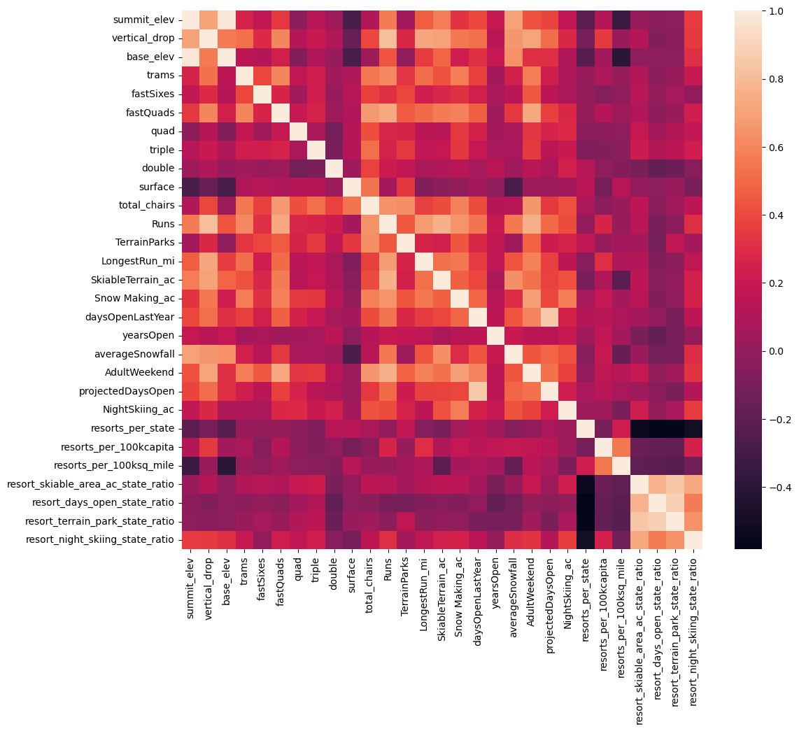
Summary and Conclusion
Summary of the journey from baseline model to random forest model.
Key recommendations and rationale.
Importance of the chosen model for business decisions.

